Slide 1

Gym Management System and AI Integration
CHIRAG JAIN(E22BCAU0016)
AYUSH SINGH(E22BCAU0010)

Slide 2
Contents
Introduction
Abstract
Methodology
Experimental Results
Conclusion
References
Thank You

Slide 3
Introduction
This presentation introduces the implementation of an advanced Gym Management System integrated with Artiﬁcial Intelligence (AI) technology. The system aims to streamline administrative tasks, enhance member experience, and optimize operational eﬃciency within the gym. Through the use of AI-driven features, such as attendance forecasting, personalized recommendations, and churn prediction, the system is designed to revolutionize gym management and member engagement. The integration of AI into the gym management infrastructure demonstrates the power of technology in improving ﬁtness facilities' effectiveness and creating a more personalized experience for gym members.

Slide 4
Abstract gym IT Solution and User Needs
Abstract
Software Used
The abstract provides an
overview of the increasing focus
on health and ﬁtness, leading to
the adoption of IT solutions for
gym management. It outlines the
development process and key
capabilities of the software,
emphasizing its ability to
enhance member administration,
attendance management, and
more.
Details the programming
language and tools used for the
development and implementation
of the Gym Management System,
including Python, Jupyter
Notebooks, and Database
Management Systems like
PostgreSQL and MongoDB.

Slide 5
Methodology AI Integration and Development Process
lowchart2
Anaconda
Shares the methodology for needs assessment, data
gathering, model development and training, integration with
gym management system, and continuous monitoring,
evaluation, and iteration.
Flowchart
Includes ﬂowcharts demonstrating the various stages of the
methodology, depicting needs assessment, data gathering,
model development, and system integration processes.

Slide 6
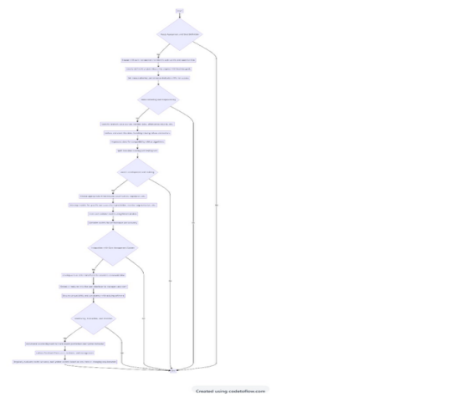
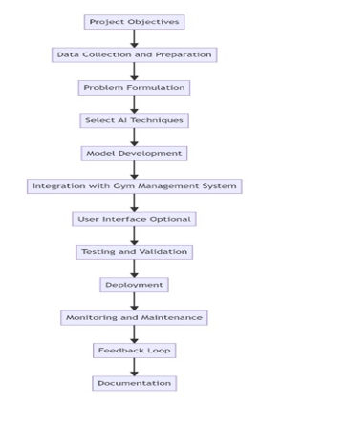

Slide 7
Experimental Results
The experimental results showcase the effectiveness of
AI integration in gym management. It includes churn
prediction, personalized recommendations, attendance
forecasting, equipment maintenance prediction, member
segmentation, feedback analysis, and operational
eﬃciency. Each aspect depicts the successful
implementation of AI-driven features and the positive
impact on gym operations and member experience.

Slide 8
Conclusion Key Outcome and Impacts
Operational Eﬃciency
Highlights the streamlining of administrative tasks, automation of processes, and operational eﬃciency achieved
through the Gym Management System's integration with AI.
2. Member Engagement and Personalization
Emphasizes the enhancement of member engagement and satisfaction through personalized recommendations,
workout plans, and targeted communications based on individual preferences and behaviors.
3. Churn Reduction and Member Retention
Showcases the proactive approach to addressing member attrition and fostering loyalty through predictive analytics
and targeted retention strategies.

Slide 9
References
[1]. Zoho. 2021. Zoho - Cloud Software Suite and SaaS Applications for Businesses. [online] Available at:
< HTTP://WWW.zoho.com
[2]. FitnessForce. 2021. Gym and Fitness Management Software | FitnessForce. [online] Available at: https:
//www.fitnessforce.com
[3]. Ltd,T., 2021. GymMaster - Health Club and Gym Software. [online] Gymmaster.com. Available at: https:/
/www.gymmaster.com/ [Accessed 27 June 2021].
[4]. Mindbody. 2021. Barre Studio Software | Mindbody. [online] Available at: https:
//www.mindbodyonline.com
[5]. I. a. I. Development. [online] Available at:
https://www.techopedia.com

